Slide 1
Drawing Types and 3d options

Slide 2
Drawing Types
Customer
Production
Sales Proposal
Submittal
Record
Overall “DB”
Marketing Illustration
Rendering
Pole Assembly
Arm Assembly
Piece Parts
Individual Piece Parts
Sub-assembly Piece Parts

Slide 3
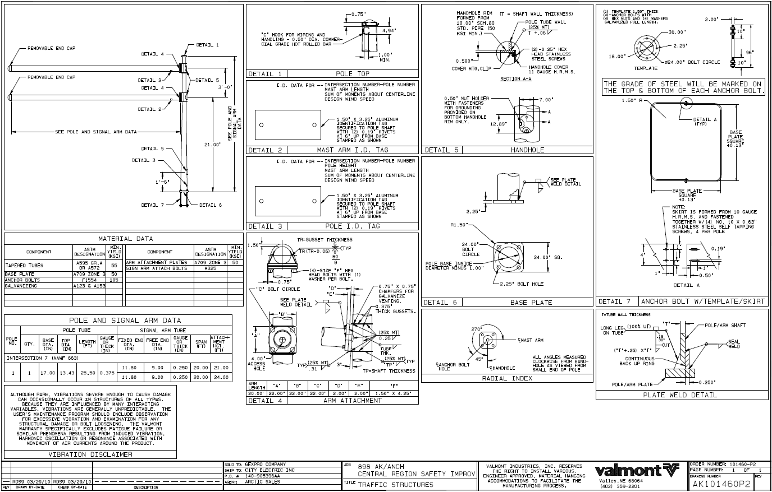
Sales Proposals / Submittals / Record Drawings
(Initial Drawing)
(Approval Drawing)
(Owner Drawings)
Notes:
All three of these drawings are the same, but are given out at different stages. The sales proposal at the initial drawing. Submittals are used for approval drawings. At this point the project hasn’t been released yet. Then we have record drawings. The project has been released and these drawings have been sent out with the owner.
Dif of each is when you request drawings
Submittal is at order stage – used for approval drawings
Record drawings sent out with record of owner

Slide 4
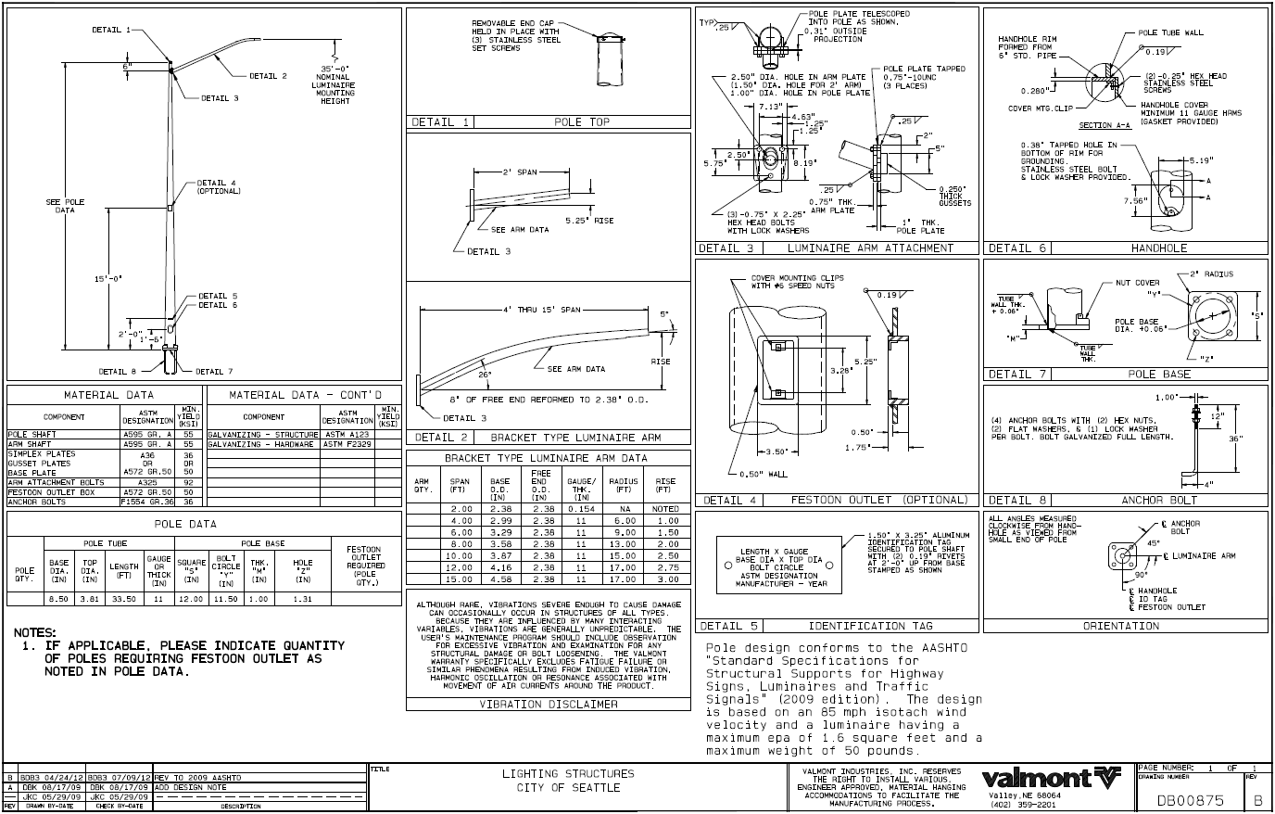
DB Drawings
Notes:
Very standard product for certain groups
Reference drawings for drafting

Slide 5
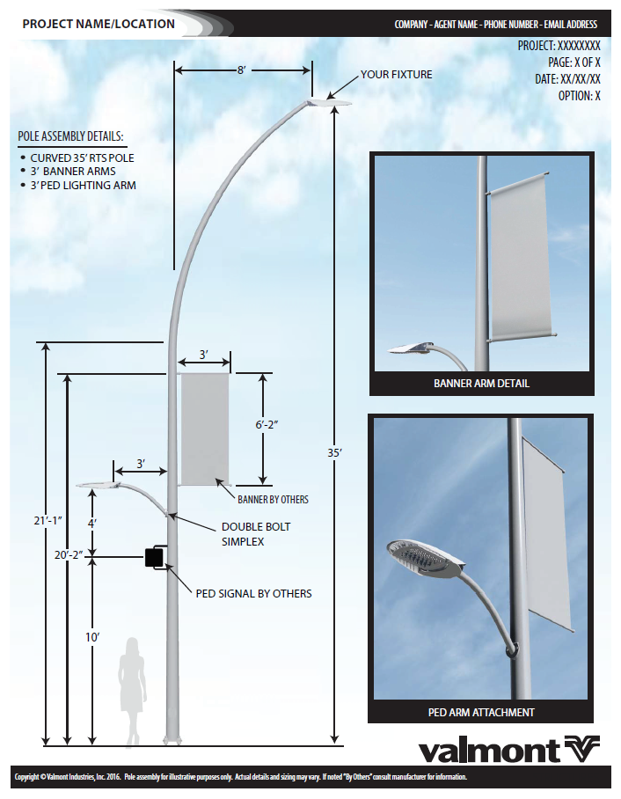
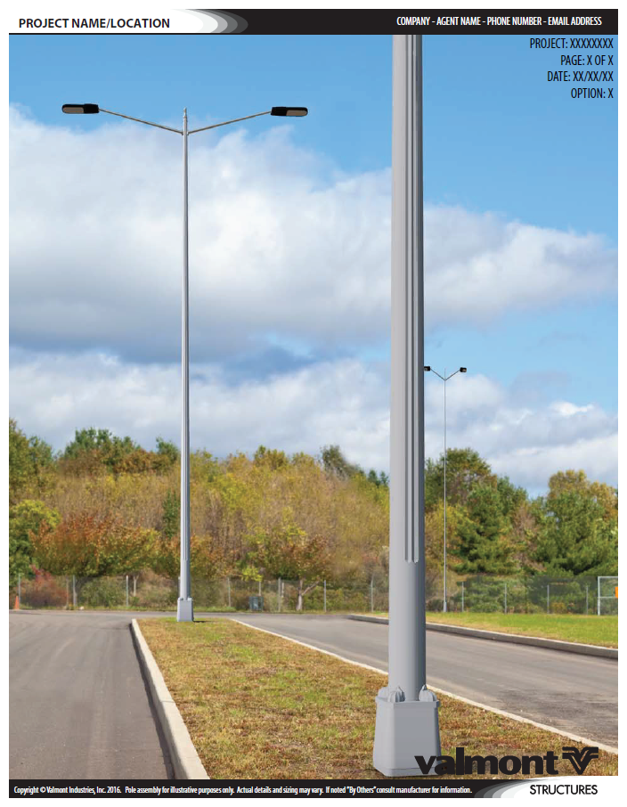
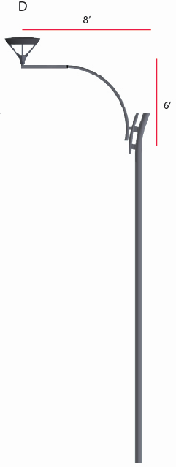
3D Options
Marketing Illustration
Photo Rendering
Concept Design
Request through your Project Administrator (PA) or Quotes contact
Notes:
Add on to submittal and sales proposals
Show std or decorative options
You now have access to three different options: Marketing Illustrations, Photo Renderings, and Concept Designs. I’ve had some emails and phone calls asking how to access these tools. This is not something you do on your own. When you have a need for one of these 3D options, you will send these requests through your Project Administrator and they will take care of everything internally here at Valmont. If you have a separate Quotes and Customer Service person, send the request to your Quotes contact.

Slide 6
Marketing Illustration
Detailed 3D illustration with dimensions
Project and agent information listed
Sky background
Human outline for scale
Decorative details showcased
5 business day lead time
Notes:
The first option is a 3D Marketing Illustration. This is a detailed 3D illustration with dimensions. You’ll notice it has fixture mounting heights, arm spans, banner sizes, and so on. We will list the project name and location at the top along with your company name and contact information. It will have a sky background and human outline for scale. We will also showcase the decorative details off to the side. If you want to showcase something specific, just let us know.
These Marketing Illustrations will get turned around within 5 business days from the request.
This is a great option when there are decorative or custom items on the pole assembly. You’ll be able to present this to customers so they’ll be able to see exactly what is proposed.

Slide 7
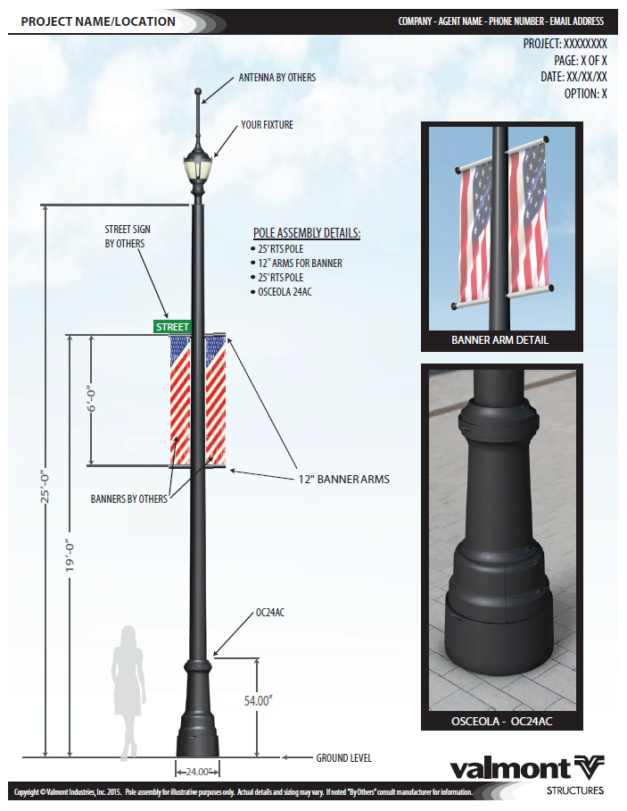
Marketing Illustration Example
Notes:
Shrunken head look – fixture with antenna
Here are a few examples.
This project required a unique antenna and the customer wanted to see how this would affect the overall pole assembly. It’s a good way to understand what everything’s going to look like before it’s out in the field.

Slide 8
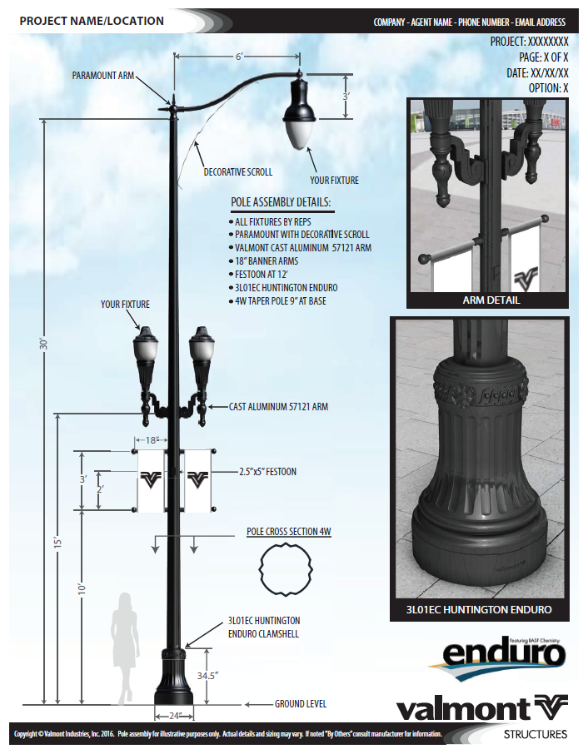
Marketing Illustration Example
Notes:
This project had a decorative arm at the top, scroll, decorative arms half way up, banners, base cover, and a unique fluted shaft. That’s a lot going on so you want to make sure they all look good together.

Slide 9
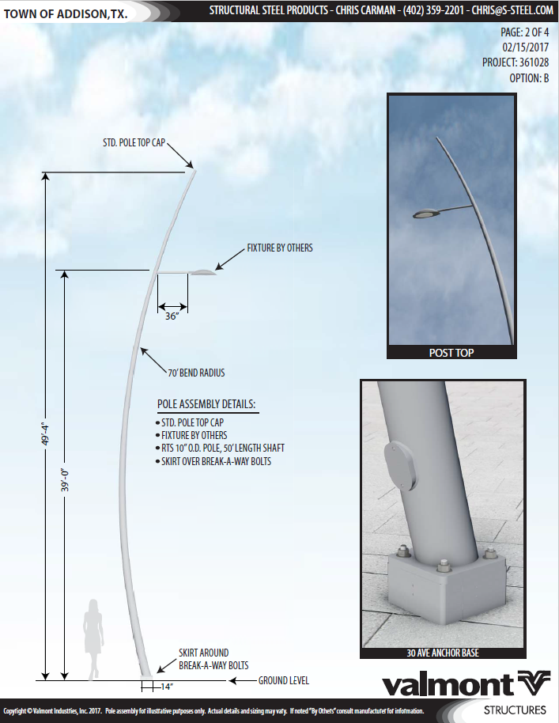
Marketing Illustration Example

Slide 10
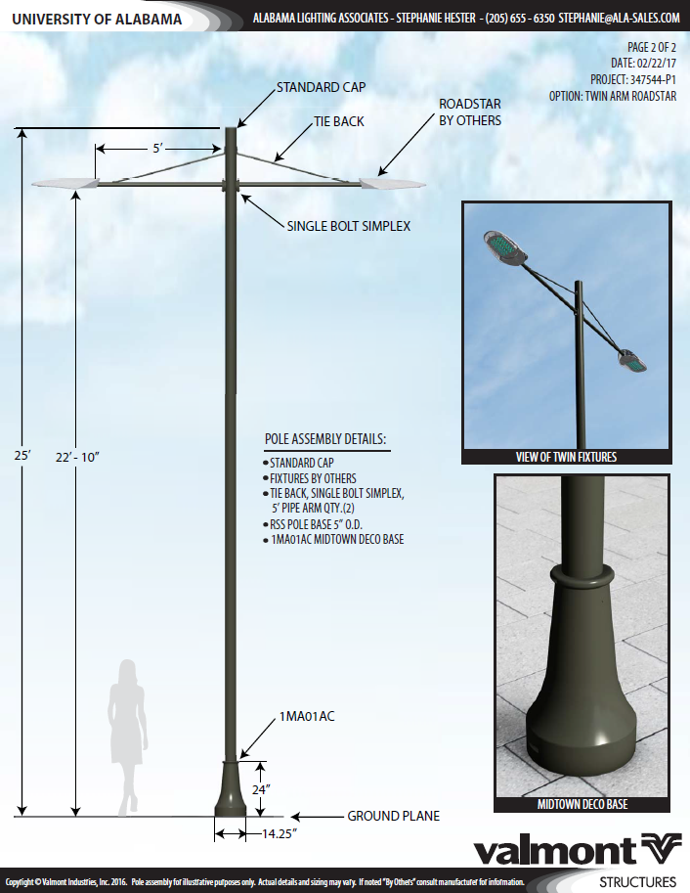
Marketing Illustration Example
Notes:
We’ll list all of the pole assembly details to reduce any confusion on what is being proposed. Like I said earlier, if you want to highlight a specific item, even if it’s your fixture, just let us know and we’ll put it off to the side. If it is your fixture, just make sure to get us the spec sheet so we can show it correctly.

Slide 11
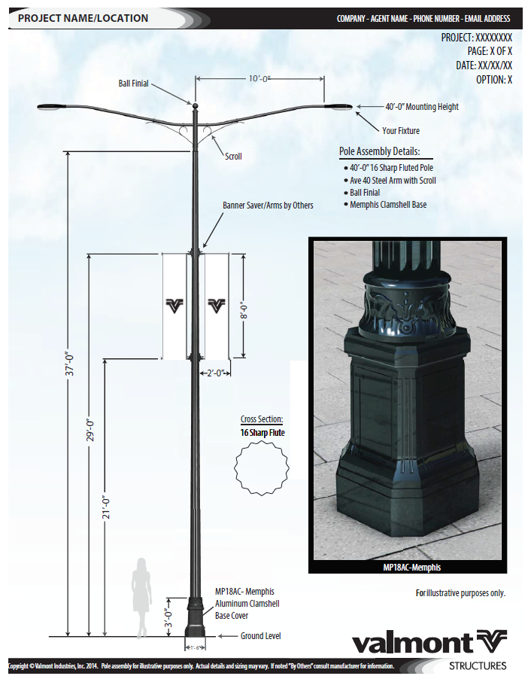
Marketing Illustration Example

Slide 12
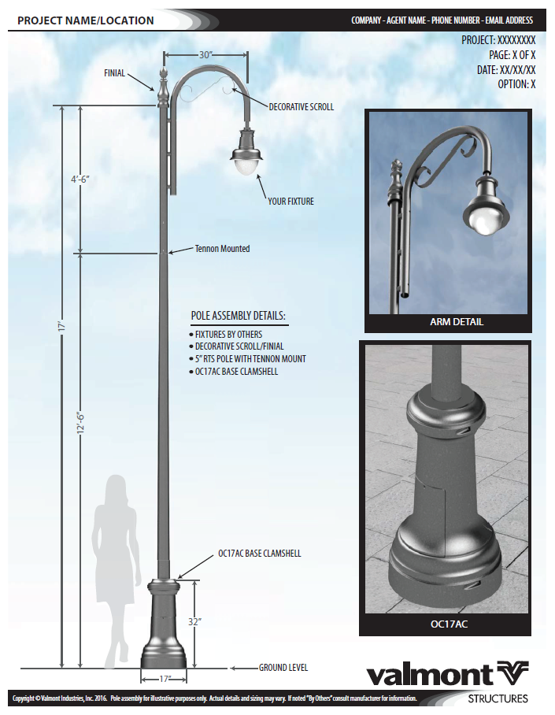
Marketing Illustration Example

Slide 13
Photo Rendering
Non-detailed 3D rendering placed in photo background
Photo background to be provided by agent
  Minimum 200 dpi
  Daytime photo
  Clear, clean perspective of the intersection or location the poles are to be placed
Marketing Illustration will be provided with the photo rendering
7 business day lead time
Notes:
Photo background provided by you – daytime
Tell us where poles are or pole replacement
We have some stock backgrounds
The next option is a Photo Rendering. The 3D Marketing Illustration that we just looked at are great but some people want to know what that specific pole will look like at their project location. This is a non-detailed 3D rendering placed in a photo background. You as the agent would need to provide us the photo background making sure it’s a minimum 200 dpi (which stands for dots per inch and if you have a smart phone, you’re more than covered), it needs to be a daytime shot, and it has to have a clear and clean perspective of the intersection or location the poles are to be placed. A 3D Marketing Illustration will also be provided with this photo rendering. The Marketing Illustration will be the first page and this Photo Rendering will be the second page. The lead time for this option is 7 business days.

Slide 14
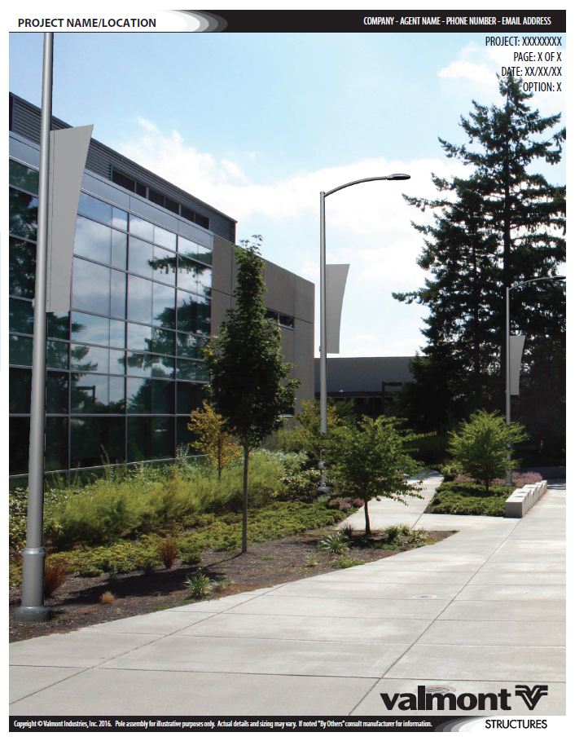
Photo Rendering Example
Notes:
Going through a few examples, you can see how beneficial this can be for a customer.

Slide 15
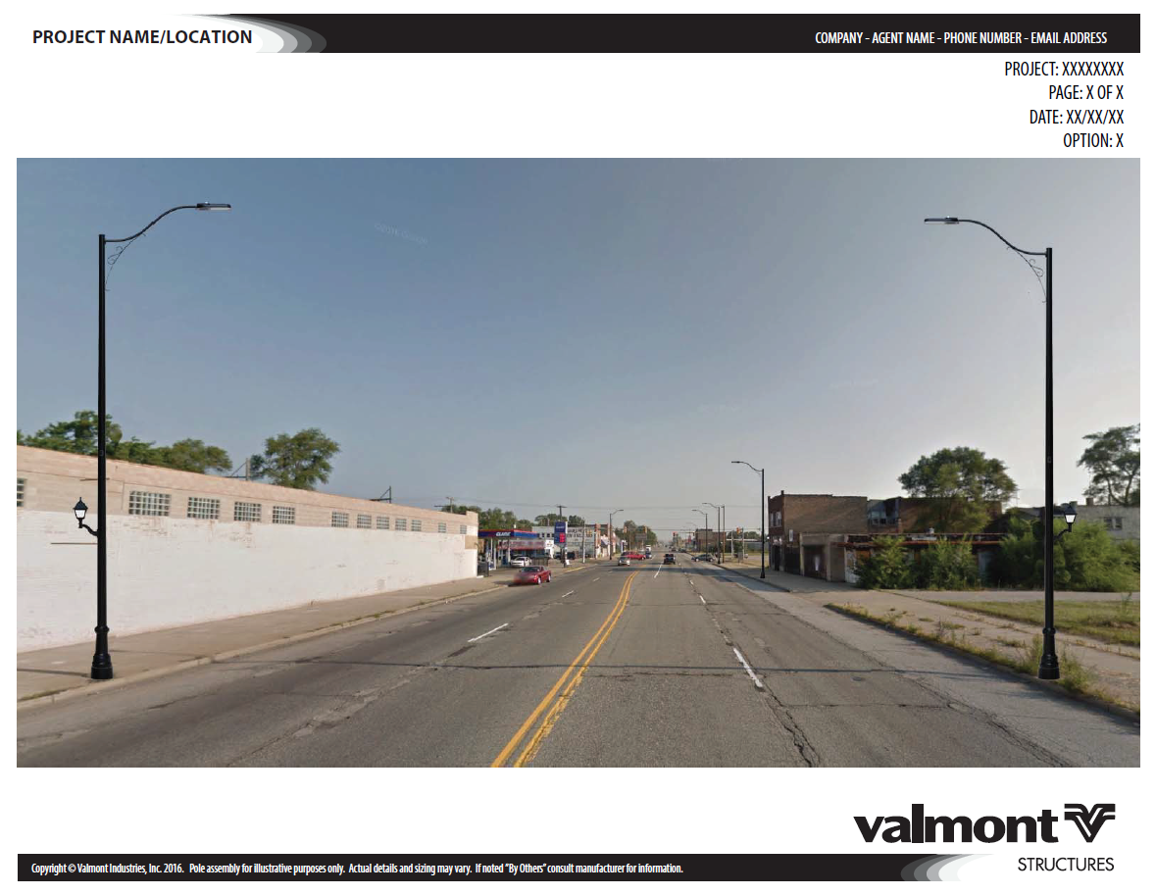
Photo Rendering Example
Notes:
It can be in landscape or portrait view.

Slide 16
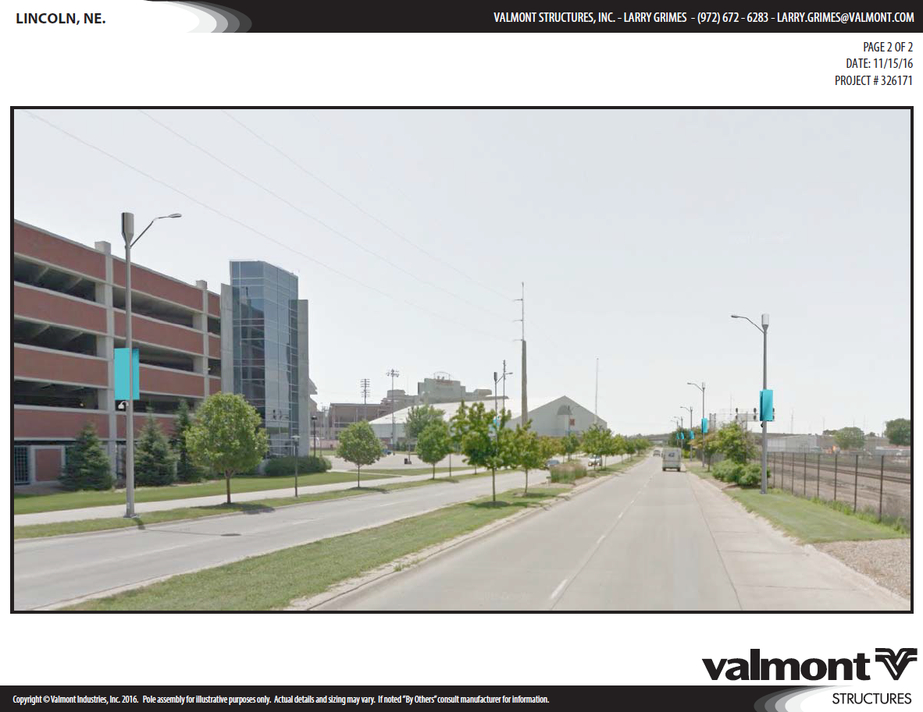
Photo Rendering Example
Notes:
It can be in landscape or portrait view.

Slide 17
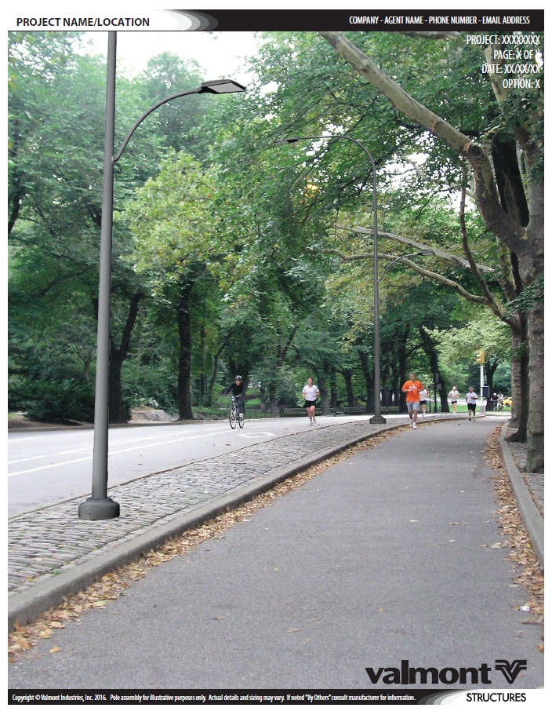
Photo Rendering Example
Notes:
A lot of individuals need to see what that pole assembly will look like in the field so these are perfect for them.

Slide 18
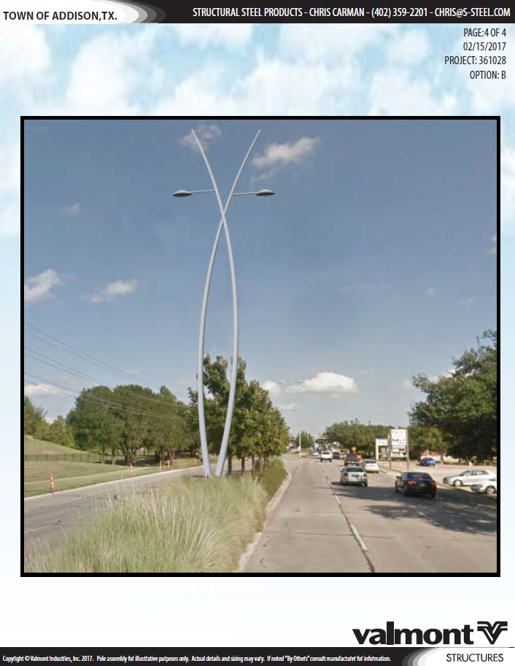
Photo Rendering Example
Notes:
Obviously, the better the picture, the better the overall Photo Rendering.

Slide 19
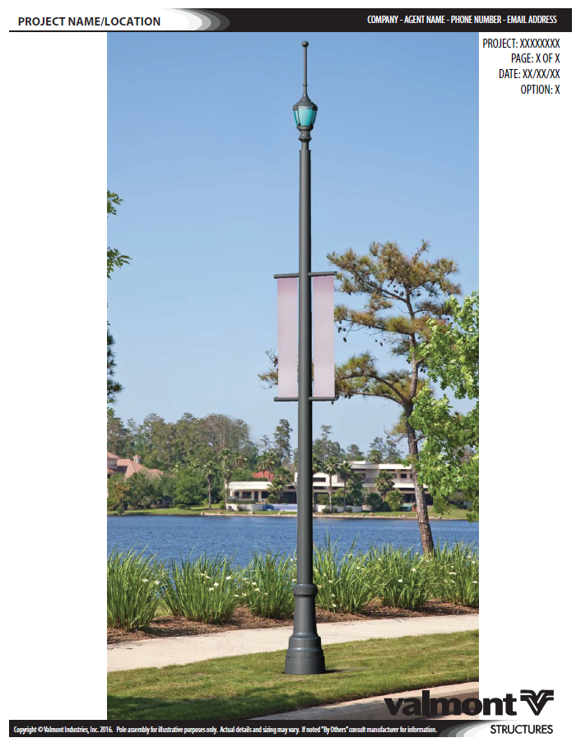
Photo Rendering Example
Notes:
Obviously, the better the picture, the better the overall Photo Rendering.

Slide 20
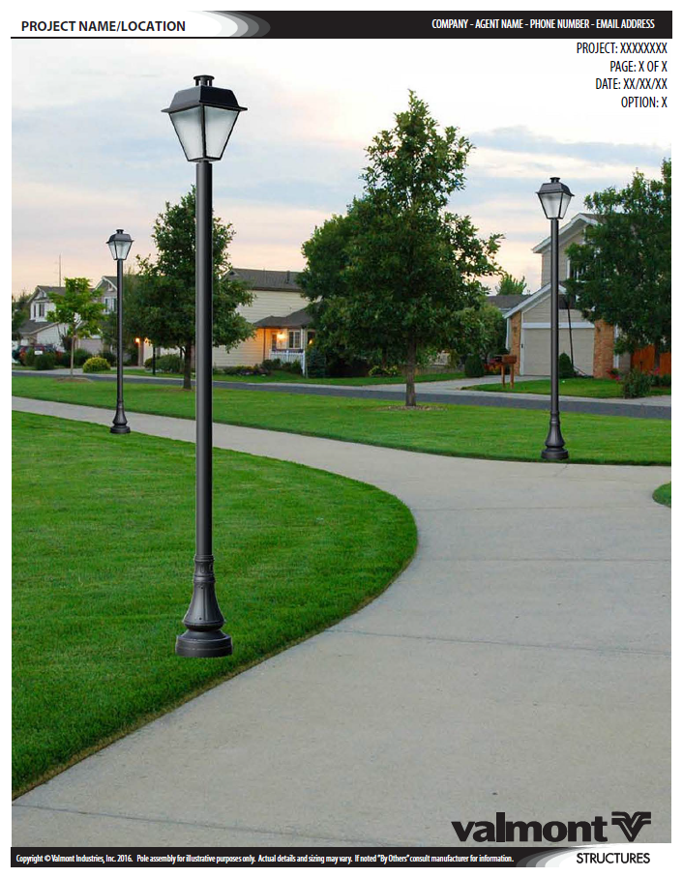
Photo Rendering Example
Notes:
This is the last example of a Photo Rendering but I think you can see how much of an impact it can have for the visual customers.

Slide 21
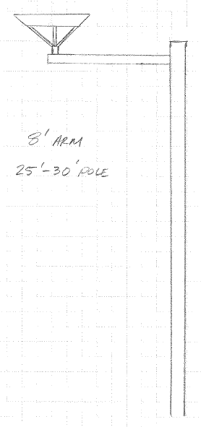
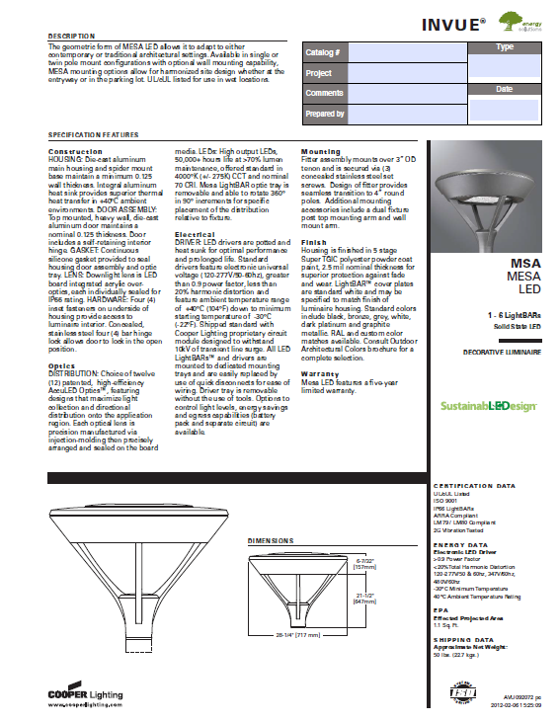
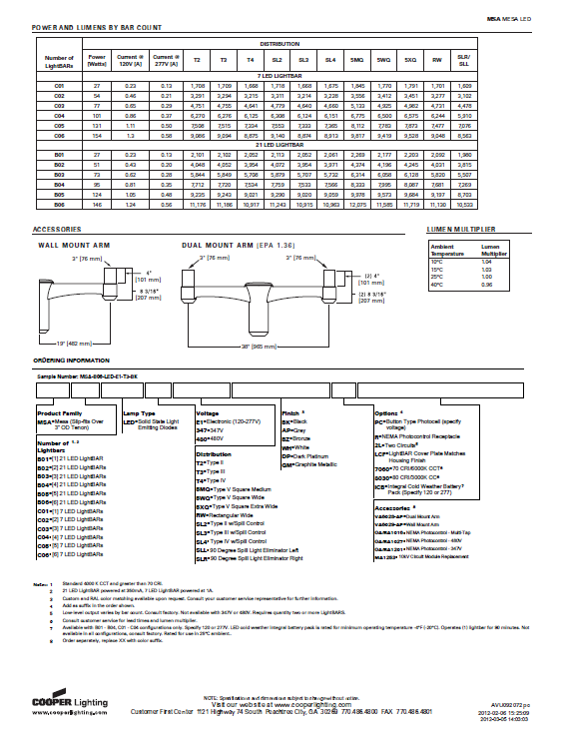
Concept Design
Creative process to develop a custom design
Product designer may reach out if questions arise
Marketing Illustration will be created after pole assembly is selected
Lead time based on complication of project
Notes:
Original sketch – wanted fishing pole design
The last option is a Concept Design. This is a creative process to develop a custom design. We see some projects where the customer knows they want a unique pole assembly but they don’t know what it should look like. You’ll still send these through your Project Administrator as mentioned before but if there are any questions, you may be contacted by our Product Designer to help the development process. Once a design is chosen, a 3D Marketing Illustration will be created. The lead time for this process depends on the complication but once we start the process and understand the need, we will provide a timeframe.
Just as an example, the sketch on the left side of the screen and fixture spec sheet was provided to Valmont. They explained they wanted some type of pole assembly that would look similar to a fishing pole and they were thinking about an 8’ arm and 25’-30’ pole.

Slide 22
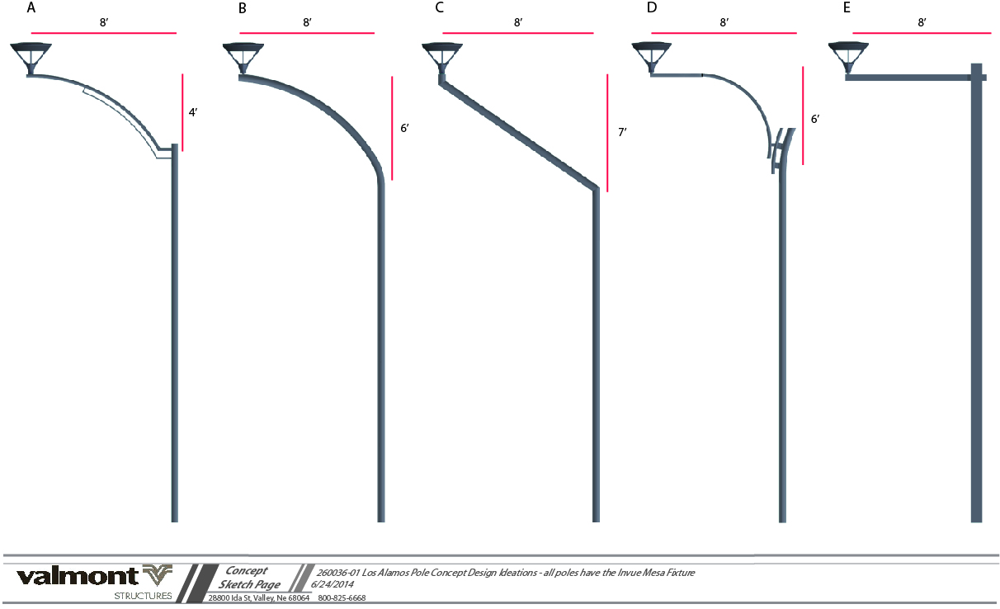
Concept Sketches
Notes:
We started the processes by providing a handful of concept sketches.

Slide 23
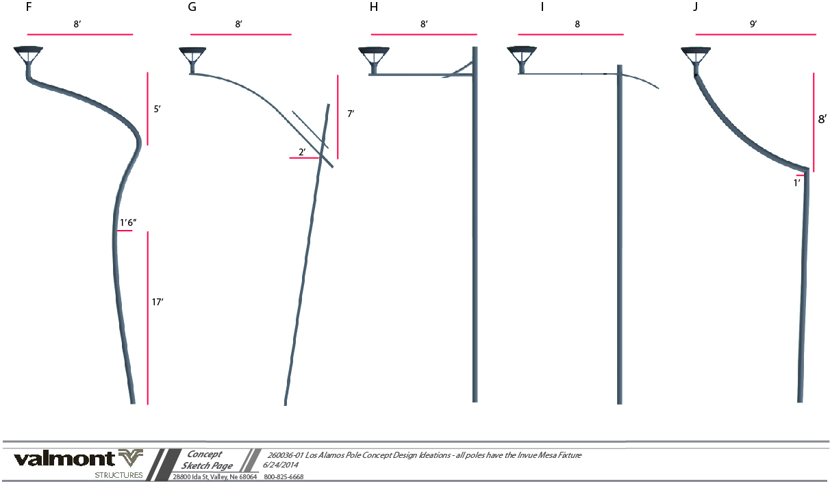
Concept Sketches
Notes:
Each concept was a little different. You’ll notice different curves, bends, and styles. This helps narrow down what the customer is looking for.

Slide 24
Decision: Concept “D”
Notes:
The customer decided concept “D” was close to what they had in mind and wanted to make a few changes.

Slide 25
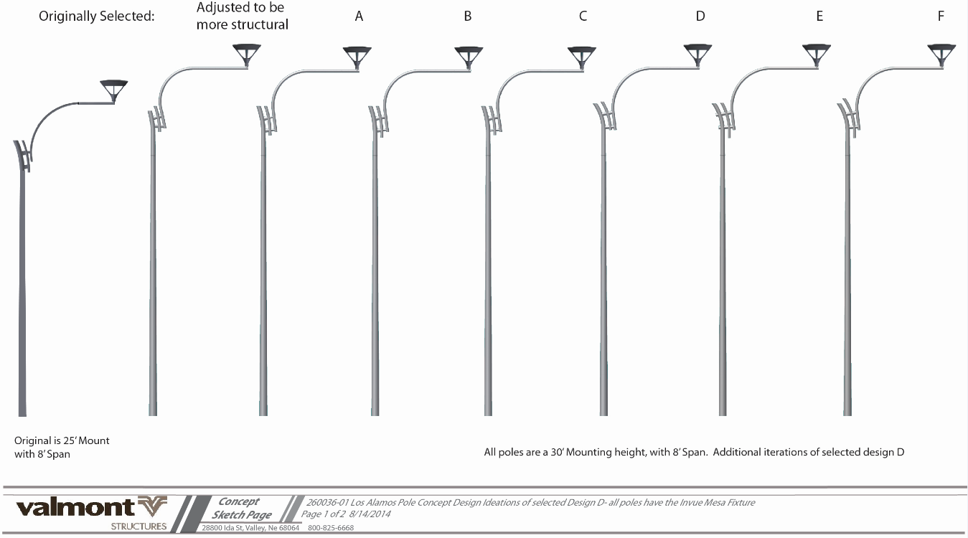
Concept “D” Design Iterations
Notes:
The mounting height was increased and the different design iterations were created showing different lengths and curves to the upper section.

Slide 26
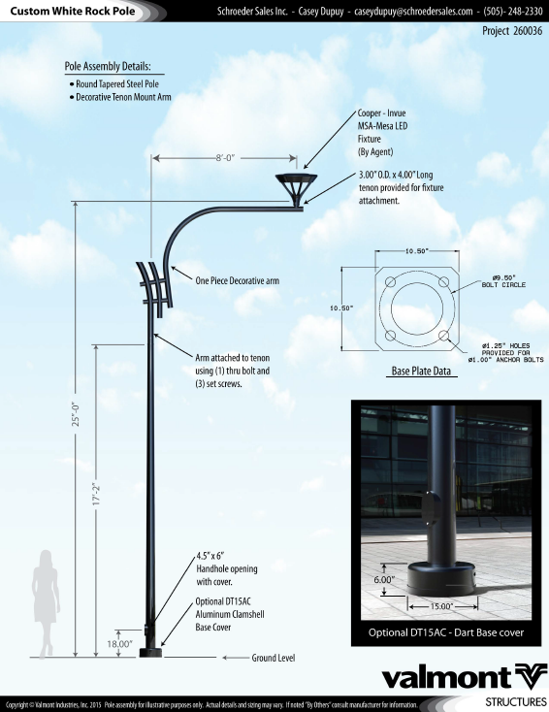
Marketing Illustration
Notes:
After the concept design was finalized, we created the Marketing Illustration. We always want to provide this Marketing Illustration so we can get your name and details on a professional looking document.

Slide 27
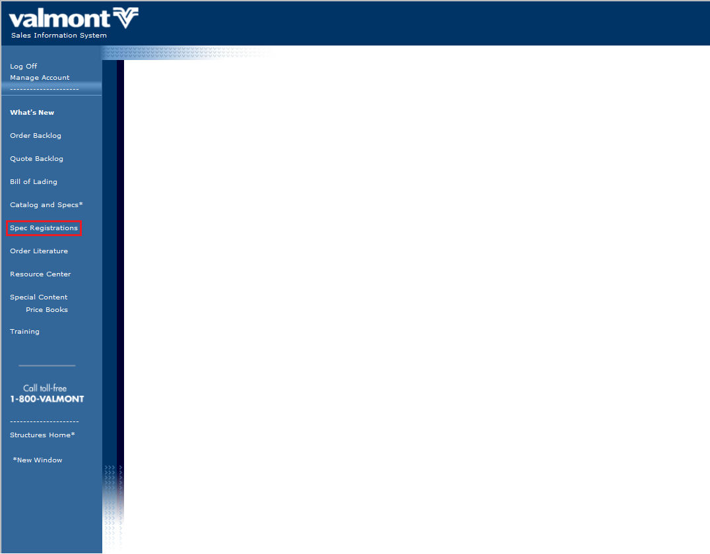
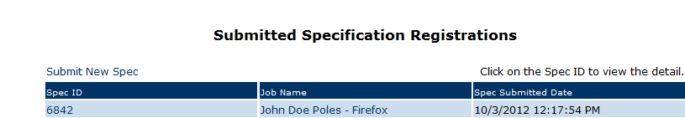
Sales Web - Specification Registration
Notes:
After the concept design was finalized, we created the Marketing Illustration. We always want to provide this Marketing Illustration so we can get your name and details on a professional looking document.

Slide 28
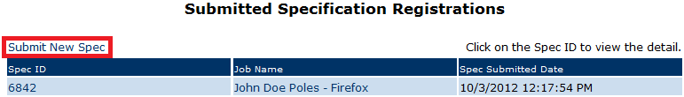
Sales Web - Specification Registration
Notes:
After the concept design was finalized, we created the Marketing Illustration. We always want to provide this Marketing Illustration so we can get your name and details on a professional looking document.

Slide 29
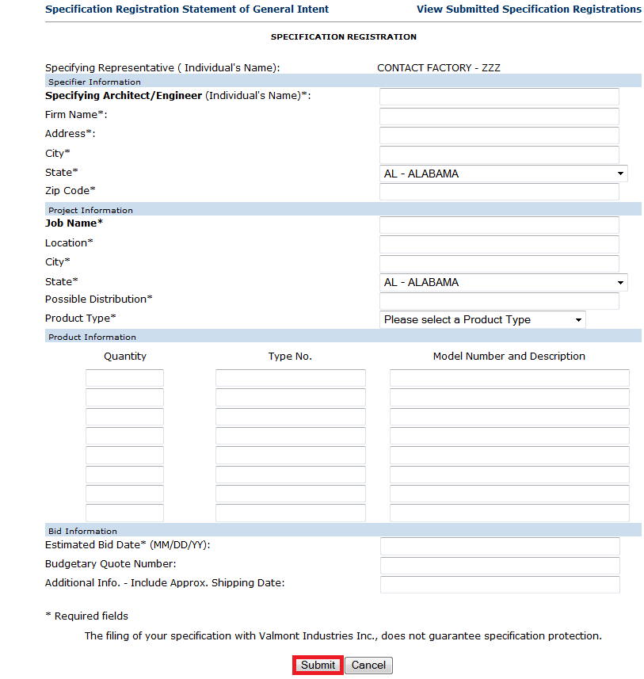
Sales Web - Specification Registration
Notes:
After the concept design was finalized, we created the Marketing Illustration. We always want to provide this Marketing Illustration so we can get your name and details on a professional looking document.

Slide 30
THANK YOU!
www.valmontstructures.com

